Slide 1
People on campus
Not-so-atheist Niamh
Niamh believes religion can't be proved but on the weekend practices tarot and manifests things that are out of her control
Clubbing Callum
His nan is Christian, and agrees with Christianity but he wants to enjoy uni before settling down to religion
Stubborn Steve
Simon is a debater, he loves to chat, he doesn’t ever think he will change his mind, but he is emotional uninvolved in debate
Polytheistic Pam
Pam was brought up Christian but has realised that all religions are just derivations of the same God.
Scientific Susan
Susan knows Christianity can't be true, because she studies a vague form of science. Big bang and evolution disprove the bible
Indifferent Ian
Unsure of proof of anything so pursues nothing
Hurt Harriet
Harriet went to a strict Christian school and cannot agree with any Christian due to the damage done by that institution
Battling Brian
Knows all organised religion is wrong as it why there are so many wars

Slide 2
Conversation starters
Hey, we are asking today….
Would like to answer a few chalkboard questions?
We are running a challenge of..
Oh so are you religious?
Can you guess which society we are?
Do you want to have a go at…
Would you like a free sweet or other free item?

Slide 3
Prayer
Prayer is good to help start evangelism, keep praying whilst in conversation and offer prayer when suitable.
Offer before you do as some really don’t like it, others really appreciate you asking even if they don’t believe

Slide 4
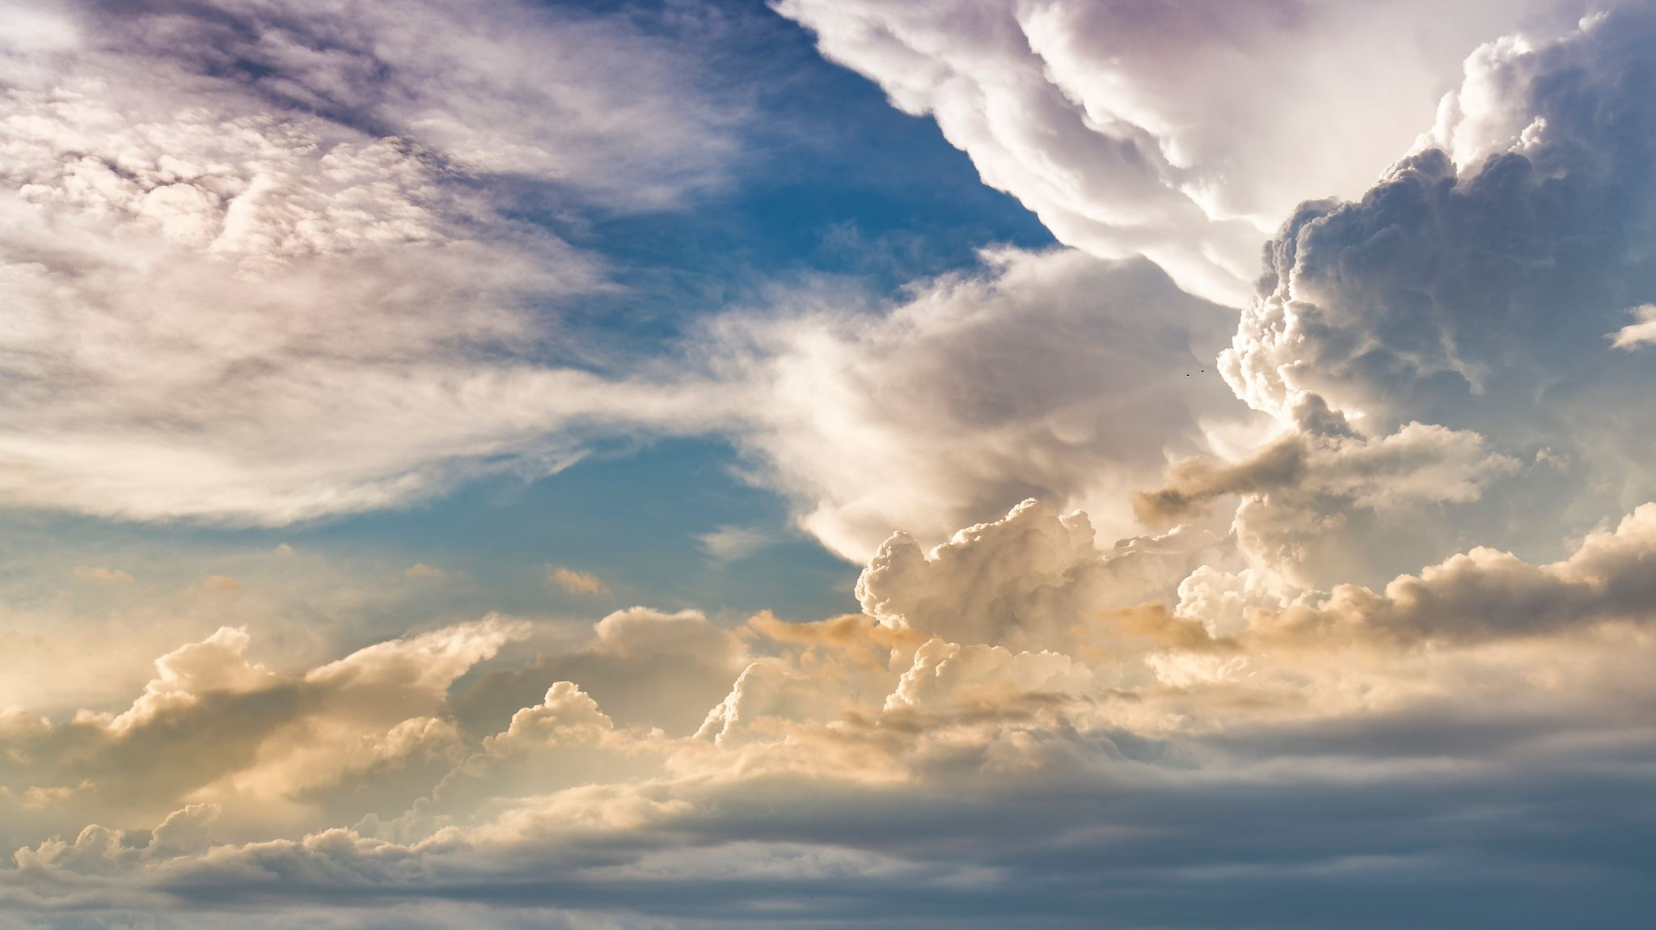
Why GOd?

Slide 5
Pascals wager
 | Believe in Christianity | Don’t believe in Christianity
Christianity is right | You can have a personal relationship with God and experience his goodness and receive eternal life | Experience consequence of unbelief
Christianity is wrong | Wasted life following Gods ways but lived in denial thus feeling fulfilled in life. | You never find out you spent a worth while life
This premise suggests that in the slight chance of Christianity being correct it is worth pursuing belief. Regardless of whether you are wrong.

Slide 6
Watchmaker analogy
Whilst walking through a woods, you notice in the distance there is a watch. How did that exist?
The argument hinges on the idea that we expect a creator from merely the existence of a complex creation.

Slide 7
Fine tuning argument
The fundamental constants of physics (e.g., gravitational constant, cosmological constant, strong nuclear force) fall within an incredibly narrow range that allows for the existence of life.
Gravity is enough that we remain grounded but not enough that we can move. We have an atmosphere that is perfect for sustaining life.
Even slight deviations from these values would render the universe life-prohibiting.
If there is infinite life that attempts to exist it is only the case that we survive because we have the perfect world
You are stating that the origin of life occurs naturally and frequently or that life spawns whenever the conditions are met which I believe are a leap

Slide 8
What about science?
The scientific method is watching, guessing, testing, and learning to find truth. Why do we expect a universal truth? Why can we establish facts, do you disagree with the fundamentals of science.
This part of science is unexplainable..
The scientific method does not have knowledge but merely expects it. But that expectation has led to science today. Why do you question it?

Slide 9
Religious experience
There can be many powerful personal experiences you can mention, however do note they will question it: using arguments such as intoxication, sleep deprivation, oxygen loss and indoctrination.

Slide 10
Cosmological argument
Everything that begins to exist has a cause; the universe began to exist, so it must have a cause.
This argument does raise into question how God existed, if everything has a cause.
But the universe isn’t unified however God is. Outside of time and consistent matches the identify of a necessary being. Everything can't come from infinite causes as that would be impossible as time now wouldn’t exist if infinite was before.

Slide 11
Moral reasoning
Why can we conclude that murder of an innocent is wrong, is there a reason why we uphold to morals?
Morals ingrained from evolutionary survival.
Why is love desired and is inherently sacrificial? Surely that would limit a species survival
Why does Murder happens
Establishment of morals doesn’t mean we uphold them

Slide 12
Why is there Suffering?
We believe that sin is the cause to all suffering. But there is a way-out of sin…
Why does God allow sin?
So, he could overcome sin. The greatest celebration is that from suffering. It is the very death of Jesus that causes the redemption of man kind
So why does hell exist?
It is separation from God, God cant be with sin and sinful beings are sinful aswell as humans are still responsible for that in which they have done.

Slide 13
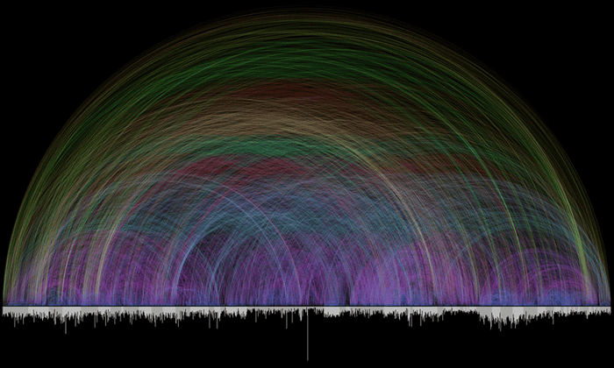
Biblical Prophesy: Isaiah 53
V 3: He was despised and forsaken of men and like one from whom men hide their face
V 4: Our griefs and sorrows he himself bore
V 7: Like a lamb to slaughter, and like a sheep that is silent before shearers
V 12: Yet he himself bore the sin of many and interceded for the transgressors.
Oldest surviving copy is 300-150 years before Christ
Great Isaiah Scroll (1QIsaᵃ)

Slide 14
Non-christian history of jesus
Flavius Josephus mentions Jesus in two passages in his work Antiquities of the Jews, written around 93-94 AD
"But the younger Ananus who, as we have already stated, was a high priest, when he was of such an age, and had a great influence in the city, thought he had a good opportunity of proving his zeal for the law, by bringing before them the brother of Jesus, who was called Christ, whose name was James, and some others..." (Antiquities 20.9.1)

